Slide 1
Open Source Intelligence (passive Recon) Company: Target
Ryan Coon
CYB-610
Professor Ian Standefer
March 26, 2025

Slide 2
Objectives
Research a fortune 500 company and one of its C-Suite officers to extract as much passive data.
Present findings of your attack
Present Spear Phishing email
Legal authorities and ethical considerations from a Christian Perspective

Slide 3

Installation

Slide 4
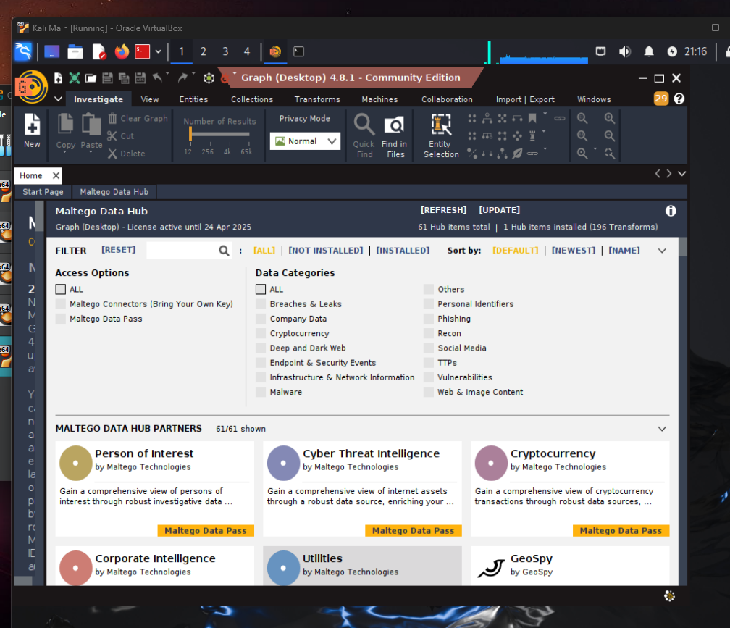
Sign up and use free
Version

Slide 5
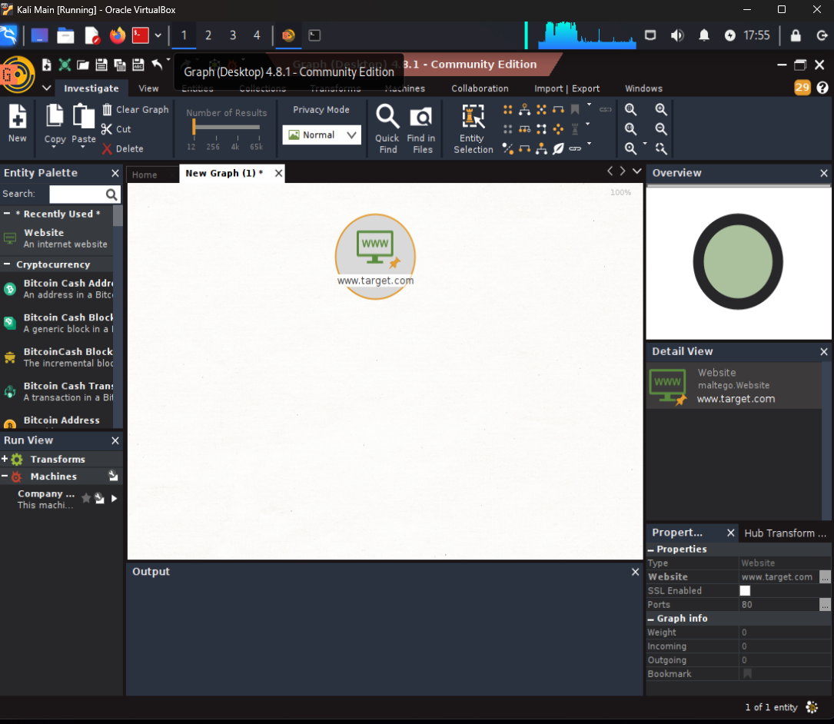
Click “new” and a
New graph will pop
up. From left menu under Infrastructure
Click and drag website to the graph.

Slide 6
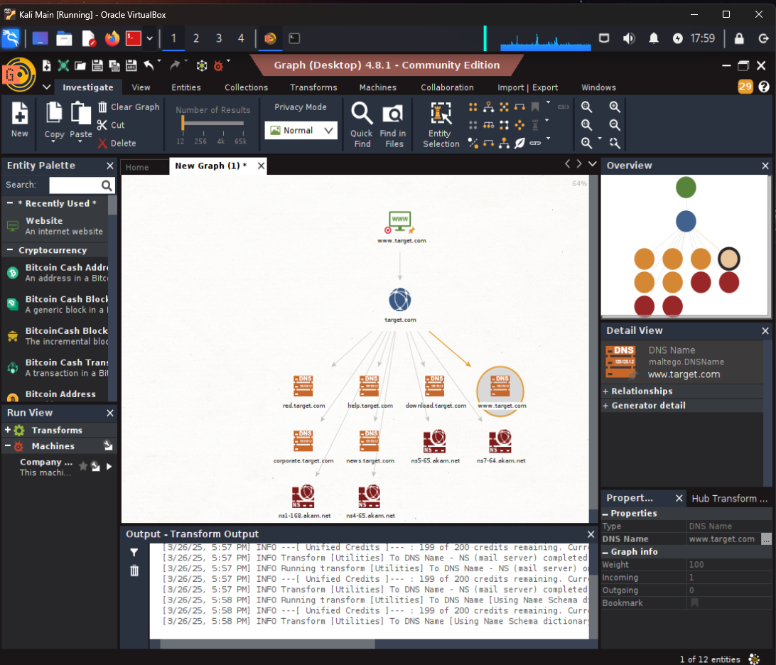
Clicked to search by DNS. The result
returned 6 entities.

Slide 7
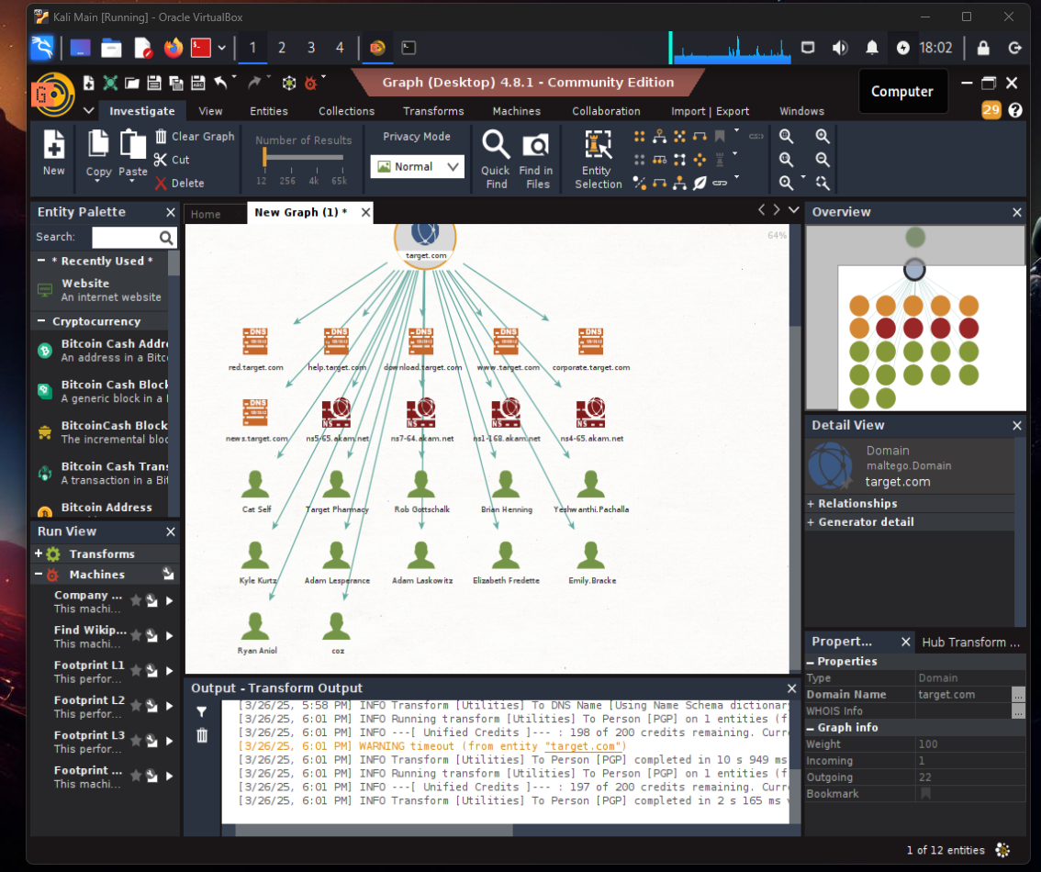
I then ran another search using “To Person
(PGP)” and 12 entities were found.

Slide 8
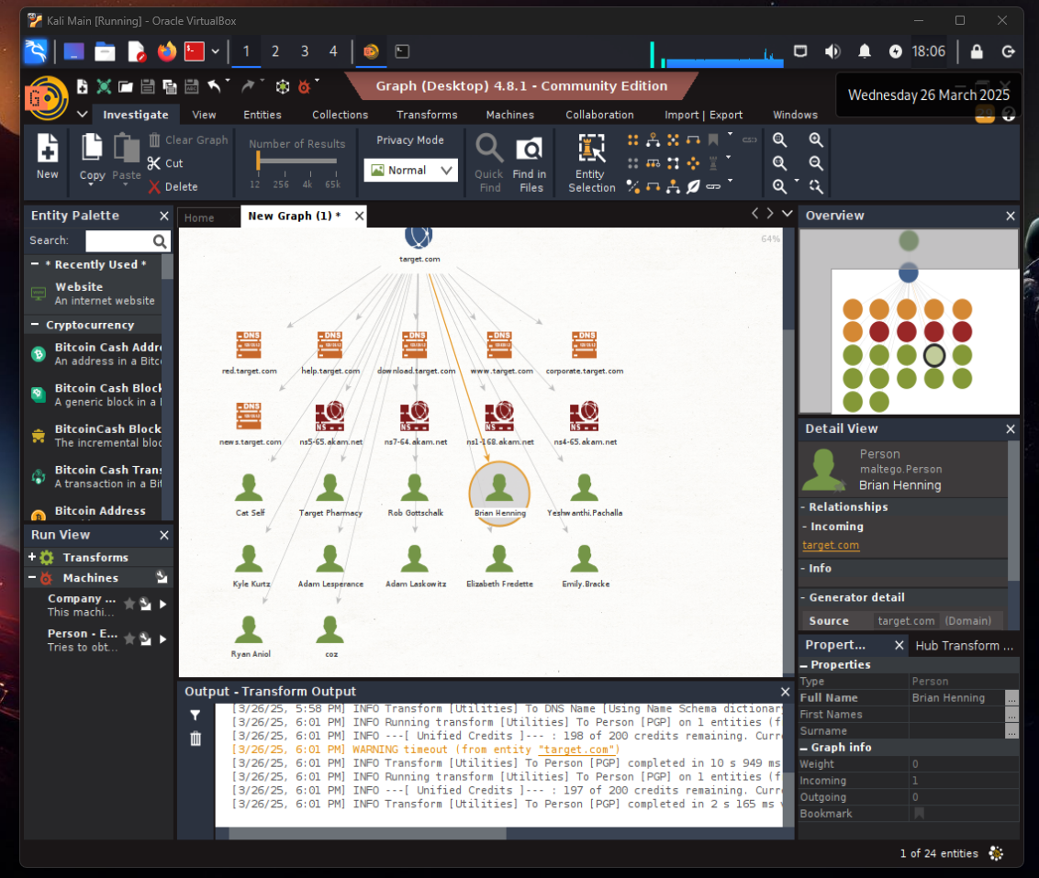
Out of the 12 I chose Brian Henning as my
perspective target

Slide 9
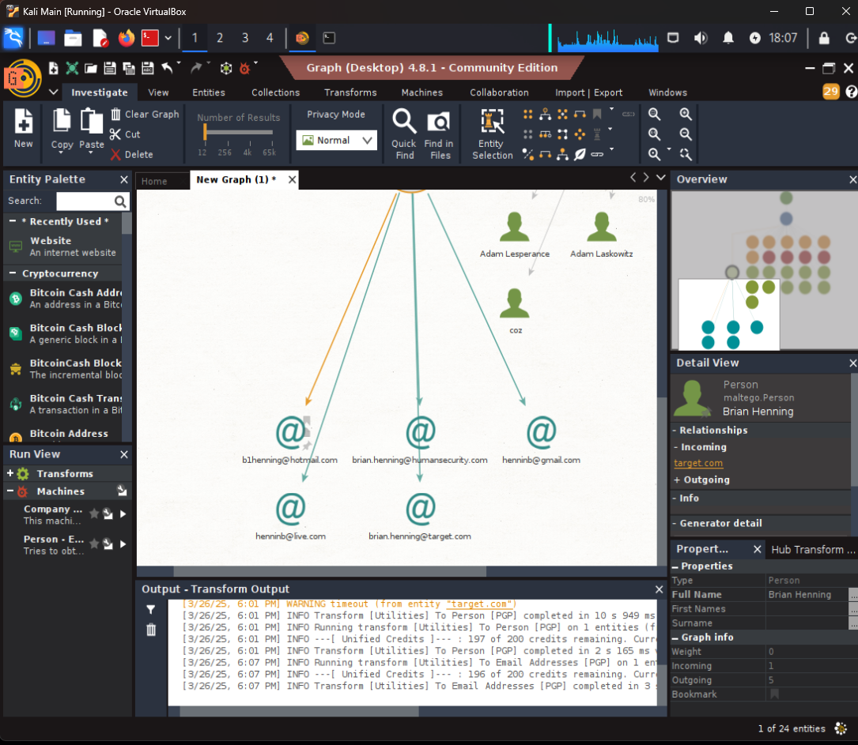
Ran the emails check on Brian Henning,
this resulted in 5 email addresses.

Slide 10
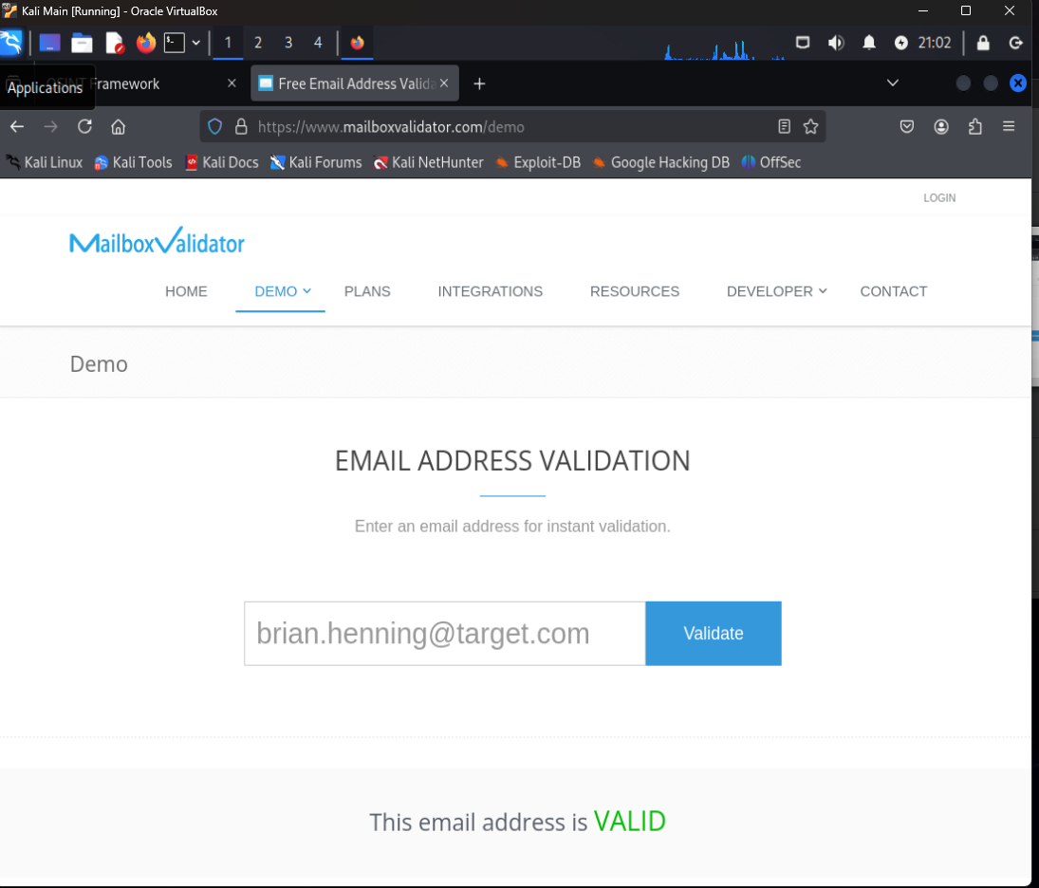
Using the OSINT Framework, chose the
Email validator, This shows that
Brian.henning@target.com is indeed
A valid email address.

Slide 11
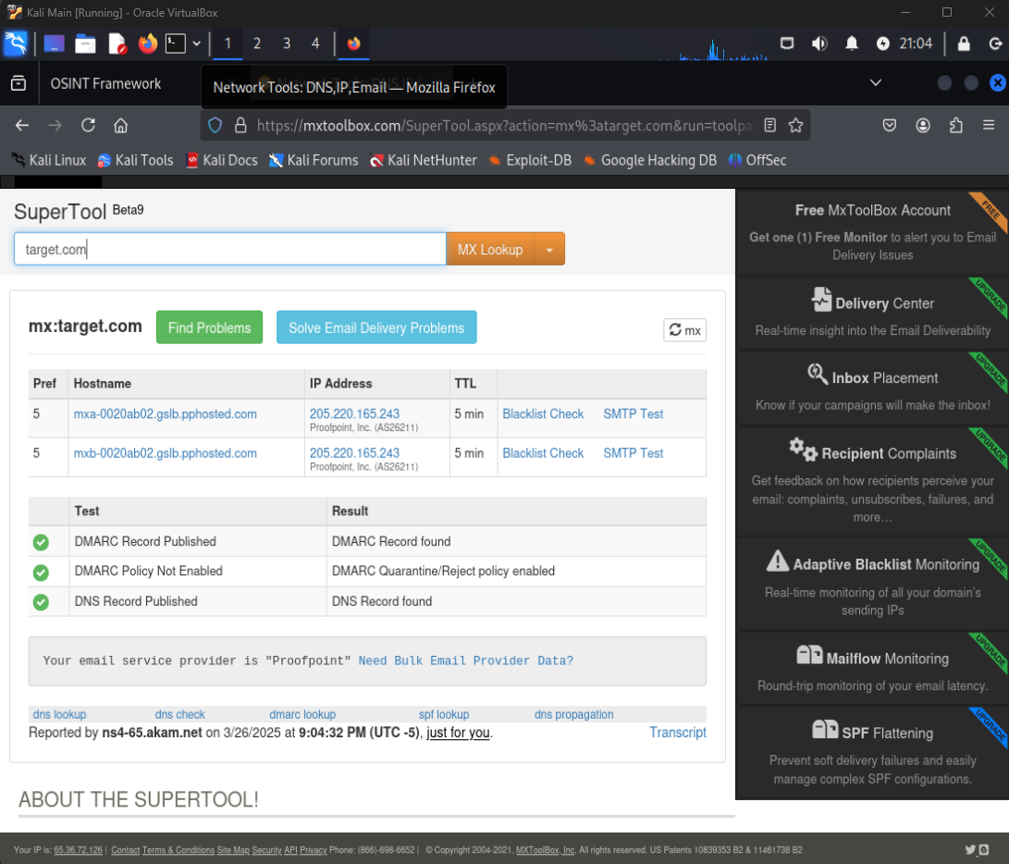
I used Mx Toolbox to do a further search
Of this email address.

Slide 12
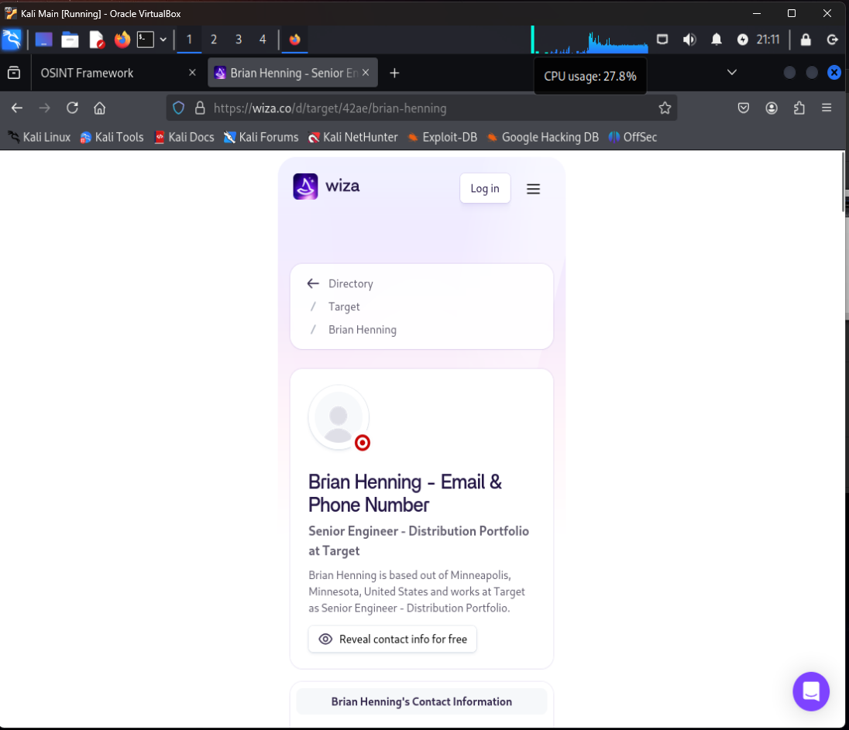
Using a simple Google search, found that
Brian Henning is a Senior engineer at Target.

Slide 13
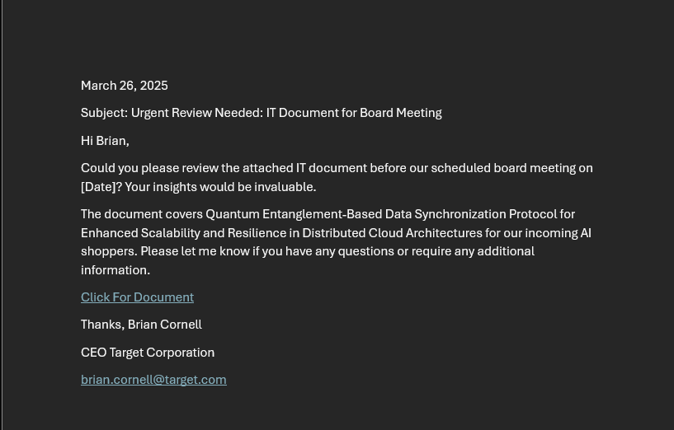

Slide 14
Legal authorities and ethical considerations from a Christian Perspective
Christian ethics demand integrity and respect in penetration testing. Obtain explicit written permission
from clients, including authorization for social engineering techniques like phishing, and strictly adhere
to legal frameworks like the Computer Fraud and Abuse Act (CFAA) to avoid unauthorized access.
While phishing is permissible within the defined scope, avoid intrusive actions or harming individuals’
dignity. Focus on educating clients on system security improvements, not just exposing vulnerabilities.
Your role is preventative; simulate attacks to strengthen their defenses. Transparency and accountability
are paramount, ensuring your actions reflect honesty and a commitment to helping organizations without
causing undue harm. As Proverbs 11:3 states, integrity guides the upright, while duplicity leads to destruction.

Slide 15
PRODUCT BENEFITS
Cool and stylish product
Areas for community connections
Online store and market swap

